Slide 1
Purdue business Analytics team
Meijer: Retail Real Estate Decision Support

Slide 2





Meet the Team
Harshraj Jadeja | Srinija S | Veda Samhitha Alluri | Husam Saleh | Shubhankar Bhajekar
Data science consultant with 4.5 years of analytical experience in retail, healthcare and telecom industry | Data Engineer with 4 years of experience in ETL and analytics in the banking industry | Data Consultant with 3+ years of experience, skilled in data migration, performance optimization, and compliance. | Aspiring Data Consultant with analytical experience in public sector and finance industry | Business Analytics student with 2.5 years of experience in construction and real estate.
hjadeja@purdue.edu | ssrimami@purdue.edu | alluriv@purdue.edu | hasaleh@purdue.edu | Sbhajeka@purdue.edu
https://www.linkedin.com/in/Harshraj-jadeja/ | www.linkedin.com/in/srinija-s | www.linkedin.com/in/veda-samhitha-alluri | www.linkedin.com/in/husam-saleh-421hs | https://www.linkedin.com/in/shubhankar-bhajekar/

Slide 3
AGENDA
Project Scope
Factors Identified/Existing
Features Sourced/Calculated:
Traffic Volume
Distance to Highway
Nearby Places
Features Readily Available
Code Walkthrough
Questions/Next Steps

Slide 4
PROJECT SCOPE

Slide 5



Project Scope
Project Outcome
Key Deliverables
Project Plan
Help Meijer prioritize locations by their score, ensuring resources are allocated to the most promising sites
Create a scoring algorithm to provide a rank/score of a given location indicating its value in pursuing it as a location for Meijer's next mExpress
Highlight the most critical factors that contribute to the success of a store location, allowing for strategic decisions based on data
Define/Align Project Goal
Data Preparation
Identify Data Sources
Scrape external data
Process external data
Integrate existing data
Feature selection/creation
Model preparation/building
Score/Rank generation per location
* indicates primary deliverable for the project

Slide 6
Features Identified/Existing

Slide 7








Potential Input Factors for Scoring Algorithm
Location based
Real Estate
Economic
Proximity to highways
Traffic volume
Nearby Hotels
Nearby Apartments
Presence of hospitals
Presence of airports
Presence of parks
Presence of stadiums
Proximity to public transportation
Nearby universities/schools
Foot Traffic Pattern
Visibility
Property Values
Rental Rates
Local minimum wage rates
Labor availability
Legal & regulatory
Competition
Safety
Border locations
Trade area barriers
Product restrictions
New entrants
Presence of Meijer’s Top Competitors
Nearby grocery stores
Local health stats
Crime rate & safety
Demographics
Seasonality
Population
Household size
Household Income
Shopping pattern
Age Distribution
Population trends
Tourist Spot

Slide 8
Traffic volume & Distance to Highway

Slide 9
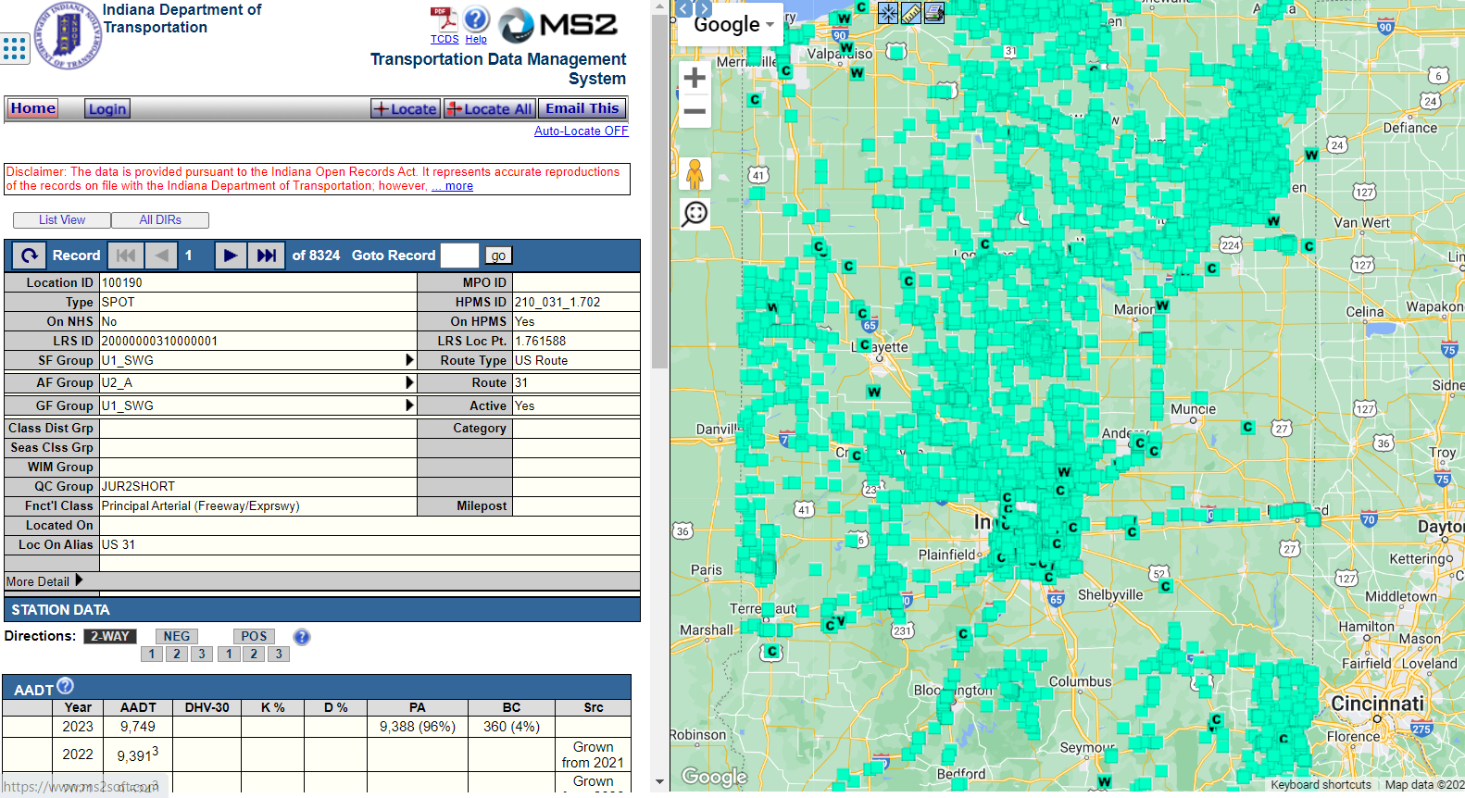
Traffic Volume
Identify States
Data from Department of Transportation
Identify Counties
Identify Location IDs with Latitude & Longitude
Annual Average Daily Traffic
https://indot.public.ms2soft.com/tcds/tsearch.asp?loc=Indot&mod

Slide 10
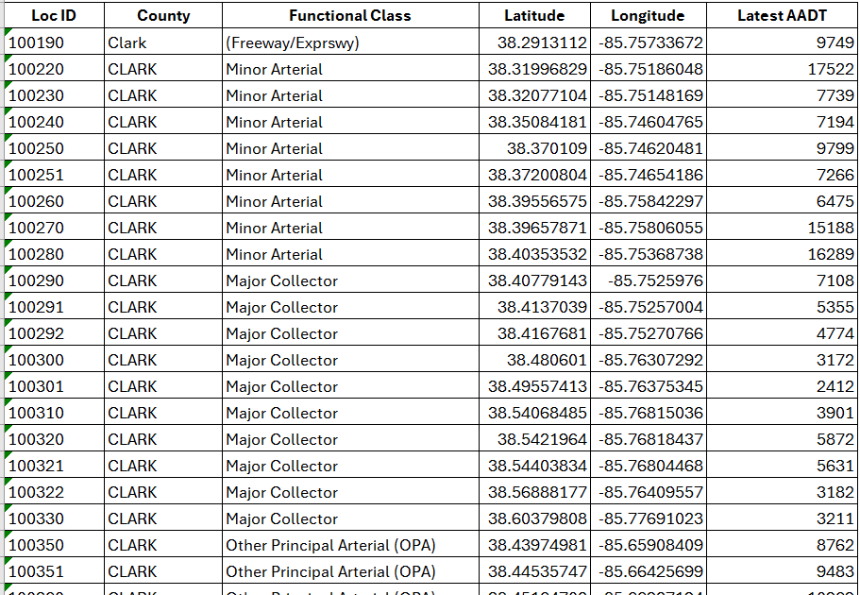
Traffic Volume
Year
State
Location ID
County
Latitude
Longitude
Type of Road
Annual Average Daily Traffic

Slide 11
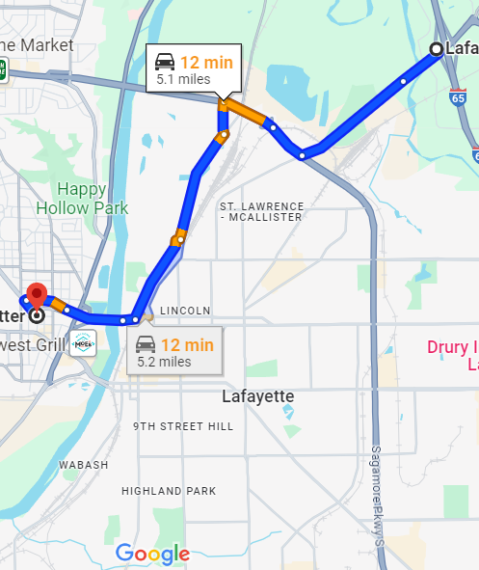



Distance to Highway
Tools used in Python
Coordinates of the Potential Location for mExpress store
Coordinates of the nearest entry/exit ramp of a highway
Driving Distance between Highway exit and mExpress store
Time taken from Highway exit to reach the mExpress store

Slide 12
Nearby Places

Slide 13
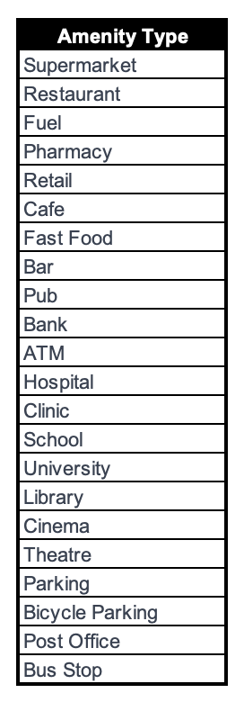

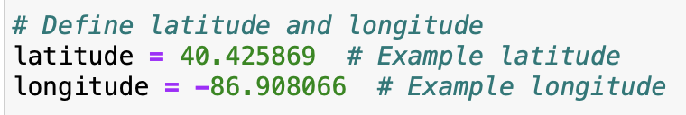
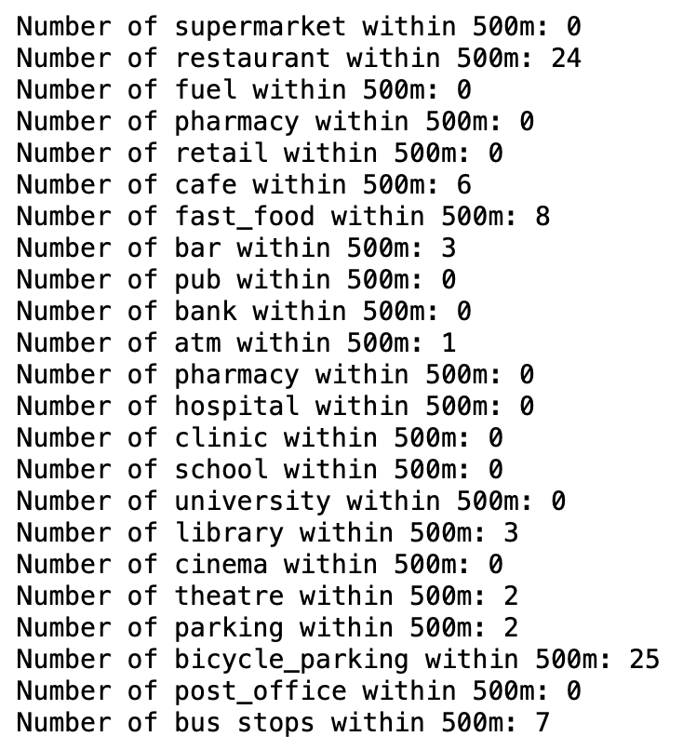
Nearby Places
Libraries:
Overpy for OpenStreetMap data
Geopy for distance calculations
I
II
Set target geographic coordinates in OpenStreetMap
Use Overpy to count local amenities from OpenStreetMap data using following functions:
count_amenities
count_bus_stops
III

Slide 14
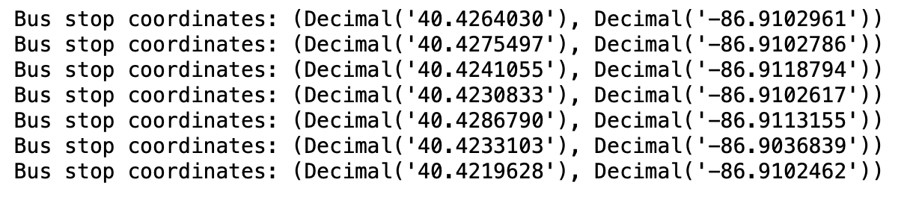

Nearby Places
Get coordinates of the nearby bus_stops or amenities.
get_bus_stop_coordinates
IV
V
Implement “find_nearest_amenity” function to locate the nearest specific amenity
Calculate distance between the bus stops or the nearest bus stop and the target location using Google Maps API
VI

Slide 15
Potential External sources

Slide 16

Property Values
Property Metrics at the level of Zip Code
Period Begin | Period End | Period Duration | Region | State | Property Type | Median Sale Price | Median Sale Price YoY | Median List Price | Median List Price YoY | Homes Sold | Homes Sold YoY | New Listings | Parent Metro Region | Last Updated
10/1/17 | 12/31/17 | 90 | Zip Code: 17098 | Pennsylvania | Single Family Residential | 118000 | 0.072727273 | 72500 | -0.194444444 | 5 | 4 | 4 | Harrisburg, PA | 1/14/24 14:20
10/1/19 | 12/31/19 | 90 | Zip Code: 95812 | California | Condo/Co-op | 1100000 | -0.290780142 | NA | NA | 3 | 0 |  | Sacramento, CA | 1/14/24 14:20
6/1/13 | 8/31/13 | 90 | Zip Code: 37701 | Tennessee | All Residential | 218750 | 1.314814815 | 136250 | 0.185813751 | 34 | 0.17241379 | 38 | Knoxville, TN | 1/14/24 14:20
8/1/15 | 10/31/15 | 90 | Zip Code: 39149 | Mississippi | All Residential | 99000 | 0.253164557 | 71500 | -0.724947105 | 1 | 0 | 4 | Jackson, MS | 1/14/24 14:20
1/1/20 | 3/31/20 | 90 | Zip Code: 68130 | Nebraska | All Residential | 349250 | 0.317924528 | 365000 | 0.050510865 | 62 | 0.31914894 | 98 | Omaha, NE | 1/14/24 14:20
2/1/21 | 4/30/21 | 90 | Zip Code: 23181 | Virginia | All Residential | 269347 | 0.178761488 | 254900 | 0.056689812 | 36 | 0.63636364 | 25 | Richmond, VA | 1/14/24 14:20
6/1/21 | 8/31/21 | 90 | Zip Code: 33810 | Florida | Single Family Residential | 275743.5 | 0.149170661 | 280000 | 0.142857143 | 190 | -0.1517857 | 195 | Lakeland, FL | 1/14/24 14:20
4/1/12 | 6/30/12 | 90 | Zip Code: 91030 | California | Multi-Family (2-4 Unit) | 759000 | -0.201052632 | 995000 | 0.020512821 | 3 | 0 | 3 | Los Angeles, CA | 1/14/24 14:20
11/1/16 | 1/31/17 | 90 | Zip Code: 97225 | Oregon | Townhouse | 390000 | 0.090909091 | 477000 | 0.454268293 | 7 | 0.75 | 6 | Portland, OR | 1/14/24 14:20
12/1/18 | 2/28/19 | 90 | Zip Code: 07432 | New Jersey | Single Family Residential | 467000 | -0.056565657 | 449000 | -0.039469462 | 18 | 0.28571429 | 19 | New York, NY | 1/14/24 14:20

Slide 17

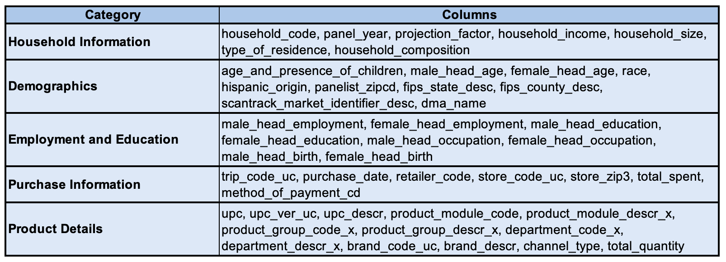


Household Demographics
Household Size
Household Income Bucket
Age Distribution
Household Education level
Household Composition
Shopping Pattern
Potential sources, if Nielsen isn’t feasible

Slide 18

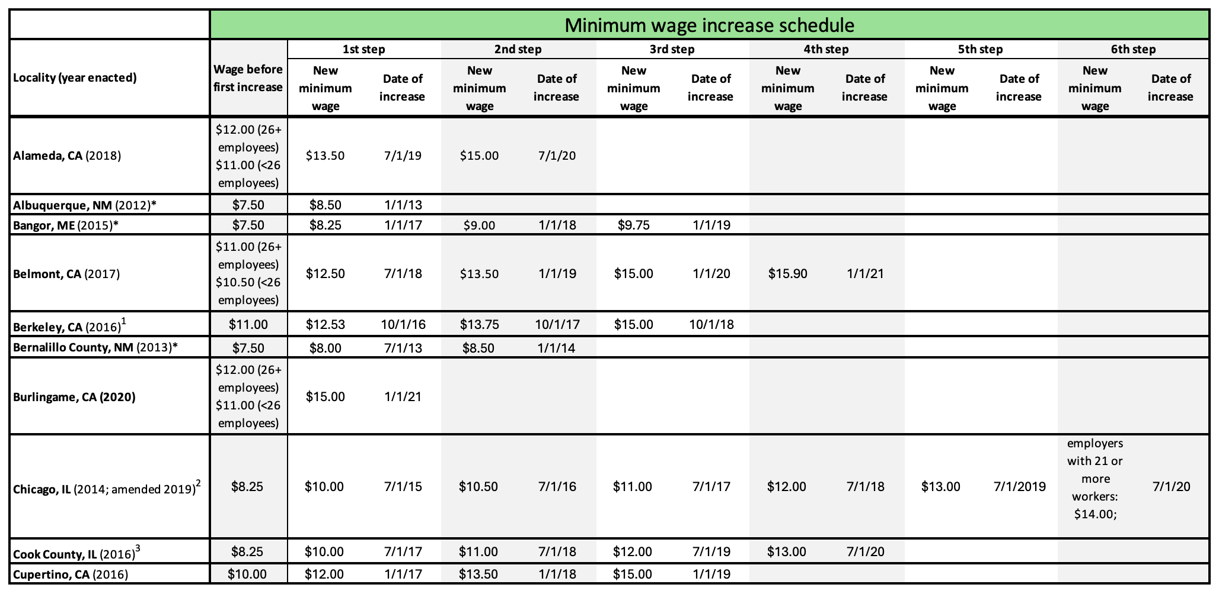
Minimum Wage Trends
Locality Based Minimum Wage
Minimum Wage Trends

Slide 19

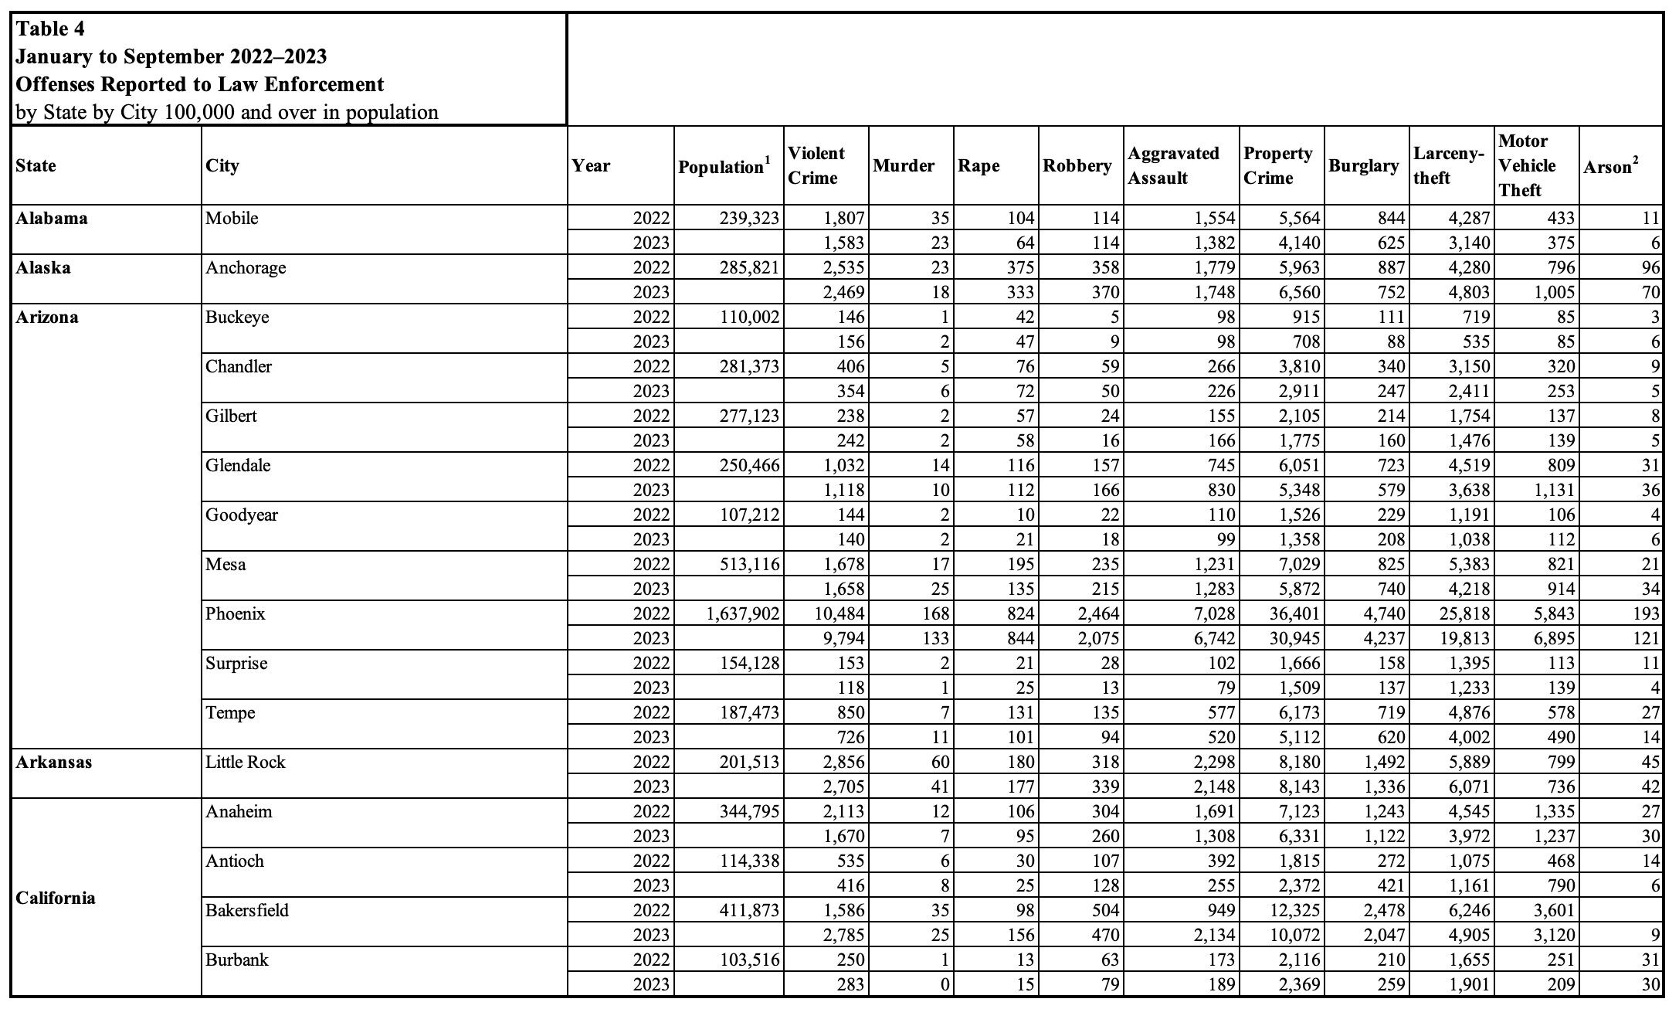
Crime Rates & Safety
Quarterly crime related metrics across cities

Slide 20

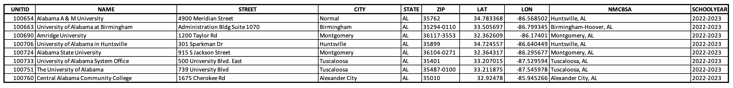


Universities/Schools
University & Schools listings at the level of latitude-longitude & school year
Next steps:
Customer sentiment score per locality/granular location

Slide 21
Code walkthrough + scraping Demo

Slide 22
Questions/Next Steps

Slide 23
Questions / Next Steps
What is the scope of the project in terms of mExpress locations? Which states are to be considered to collect data and build the model?
Can we use location IDs (latitude & longitude) obtained from the traffic volume data as markers for potential mExpress stores? Does Meijer have any locations in mind?
Apart from traffic volume and distance to highway ramps, which features should be considered important/relevant? Does Meijer have a preference?
Building a master dataset by combining data points from different features and assigning them to each of the location IDs (latitude & longitude) selected for building the model.

Slide 24
THANK YOU

Slide 25
Appendix

Slide 26
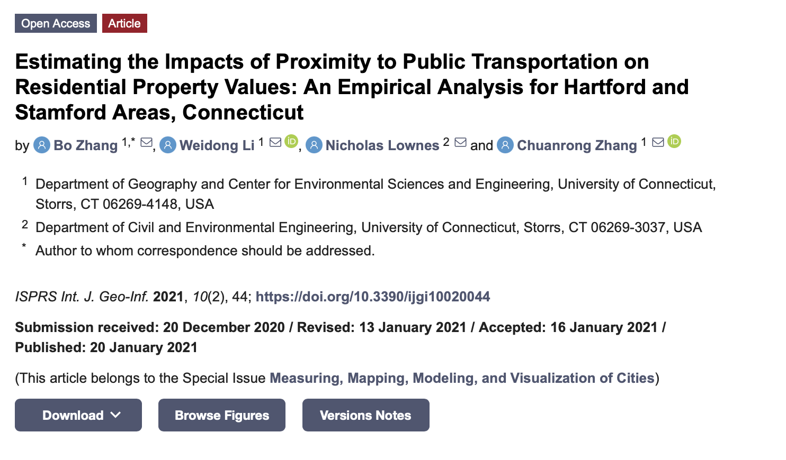
Reference Material: Research Paper Publication

